Slide 1

Movie Rating Analysis
By Faiyaz Sattar/Pui Hei Wong/ Mohammed Abbas Yunus

Slide 2
Problem Statement
Objective: The aim of this project is to predict IMDB rating using various factors available in our dataset. By identifying the key variables that influence a movie's rating such as genre, director, cast, budget, and box office performance, we intend to develop a predictive model.
Problem Statement: The primary challenge is to identify and quantify the key factors that most significantly impact the IMDB rating and to effectively incorporate these variables into a machine learning model. This entails not only selecting the appropriate data and transforming it into a usable format but also choosing the right modeling techniques that can handle the complexities of prediction in the entertainment sector.

Slide 3

Dataset Used
Source: This dataset was found on Kaggle which is used for movie data analysis. https://www.kaggle.com/datasets/carolzhangdc/imdb-5000-movie-dataset/data
Size: The dataset includes records for five thousand movies
Characteristics: Key features include genre, IMDb score, Director name , language, duration, Movie Year, Country and gross revenue.

Slide 4
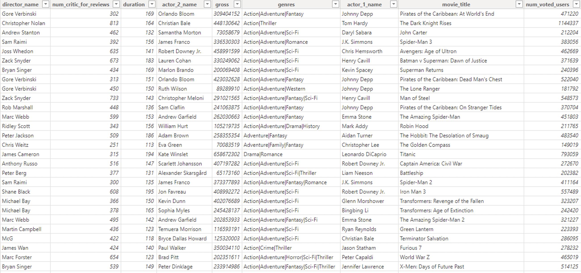
Sample of dataset

Slide 5
IMDB Rating Prediction Algorithm
Algorithm Used: Linear Regression
Purpose: To predict IMDB movie ratings using historical data.
Cleaning: Addressed missing values, outliers, and ensured consistency in categorical variables.
Feature Engineering: Created new features that were relevant for analysis, such as Primary Genre.

Slide 6

Algorithm Implementation
Steps Involved:
Feature Selection: critic reviews, duration, user votes, user reviews, budget, release year.
Data Splitting: Separated data into 80% for training and 20% for testing (with a consistent random state for reproducibility).
Model Training: Applied Linear Regression to learn from the training data.
Model Prediction: Predicted IMDB ratings for the test dataset.
Performance Evaluation:
Mean Squared Error (MSE) to measure prediction accuracy.
R² Score to quantify the variance explained by the model.

Slide 7
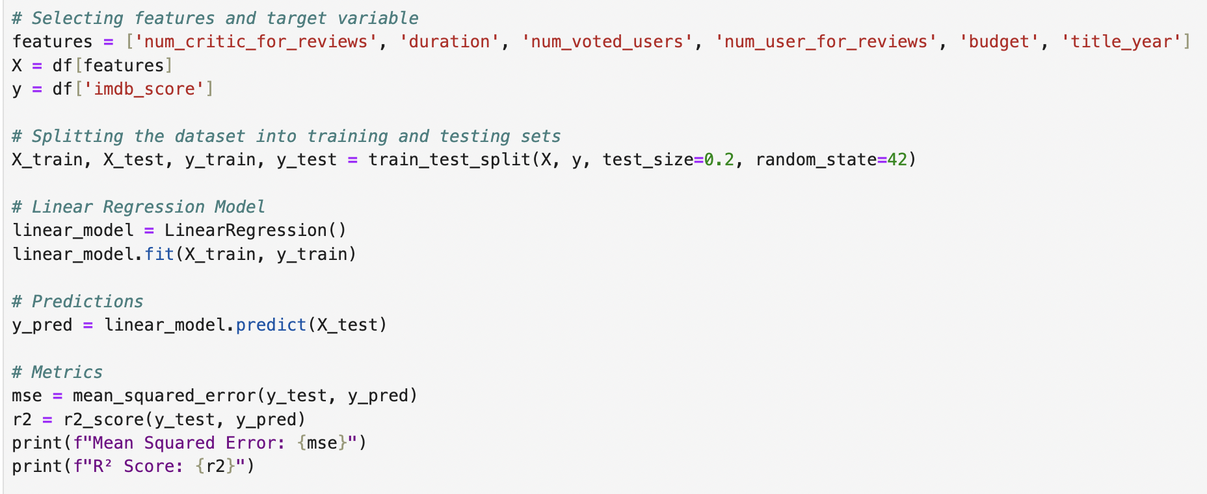
Mining Algorithm

Slide 8
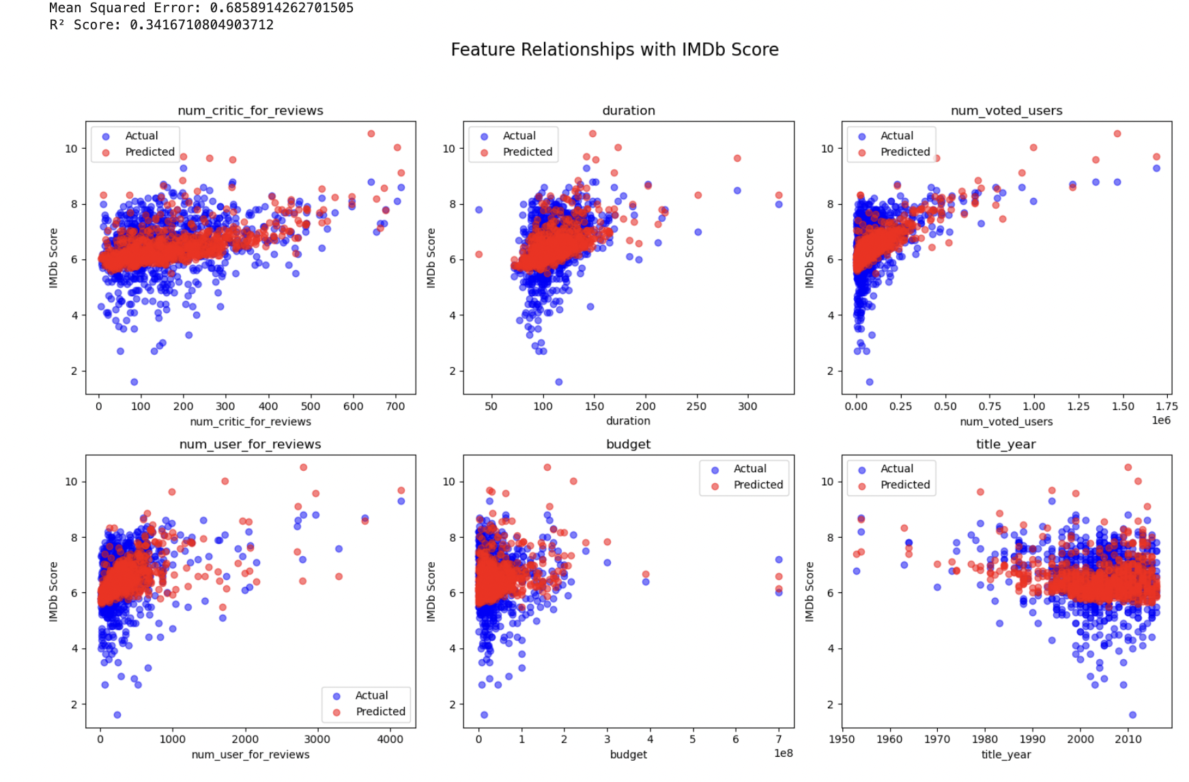
Output

Slide 9

Power BI Dashboard Outline
Few Visualizations:
A line chart showing the IMDb score change over the time
A bar chart showing the top IMDb rated movies
Relationship Between Box Office Gross and IMDb Scores by Genre in a line and coloum chart.
A tree map showing highest rated director.

Slide 10
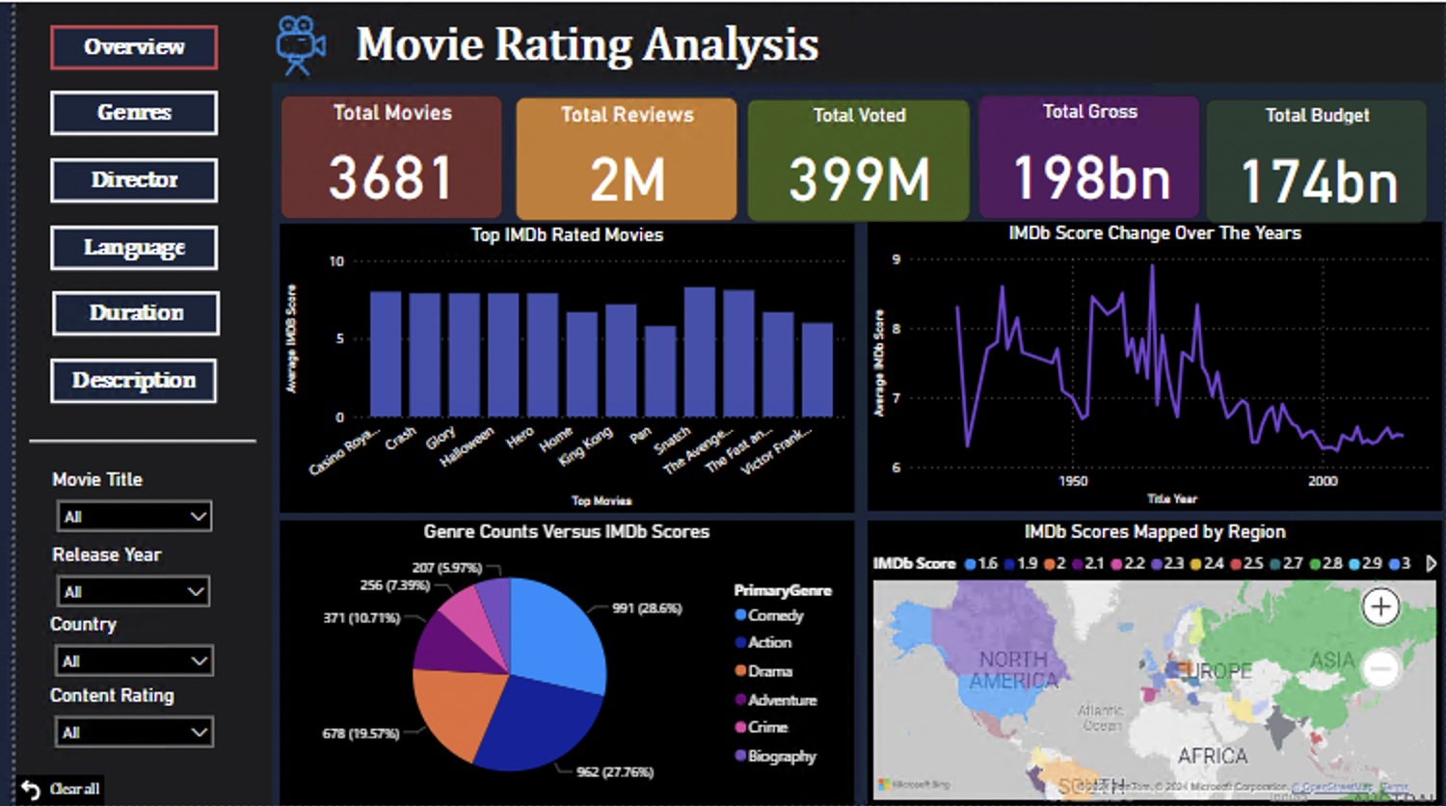
Power BI Dashboard: Overview

Slide 11
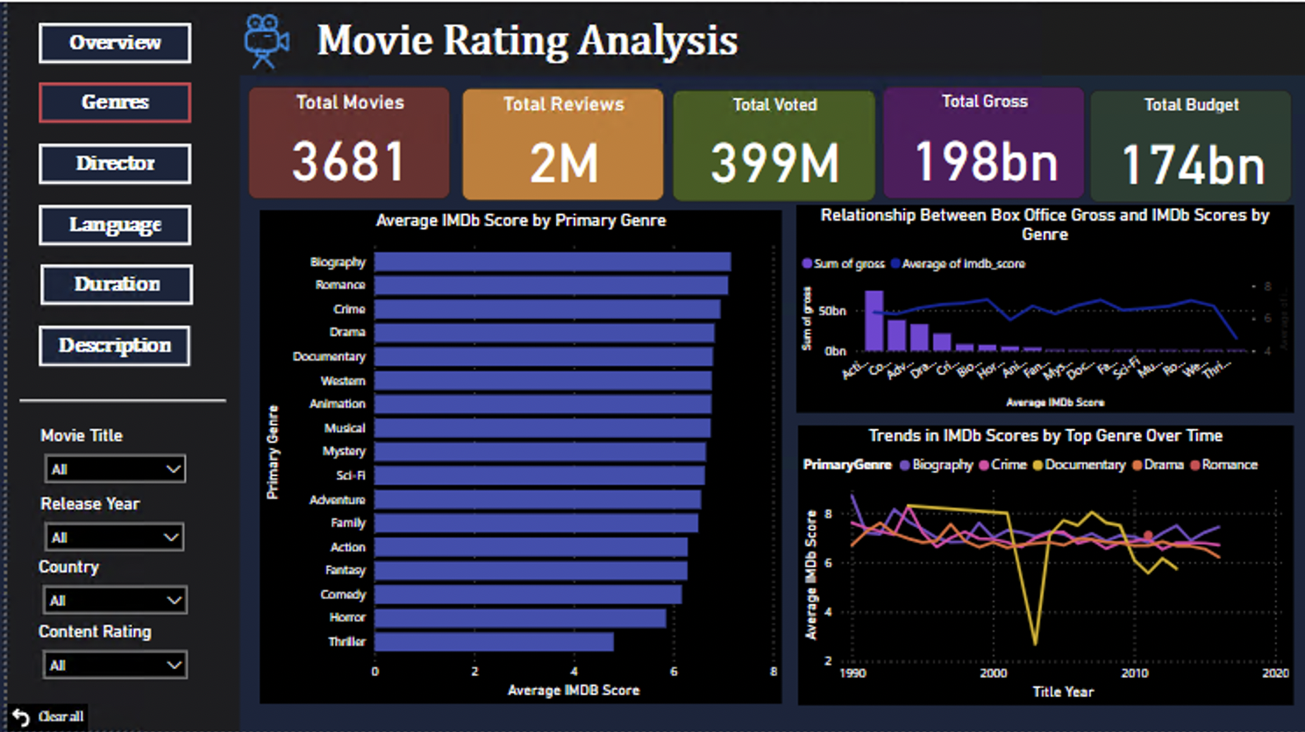
Power BI Dashboard: Genres

Slide 12
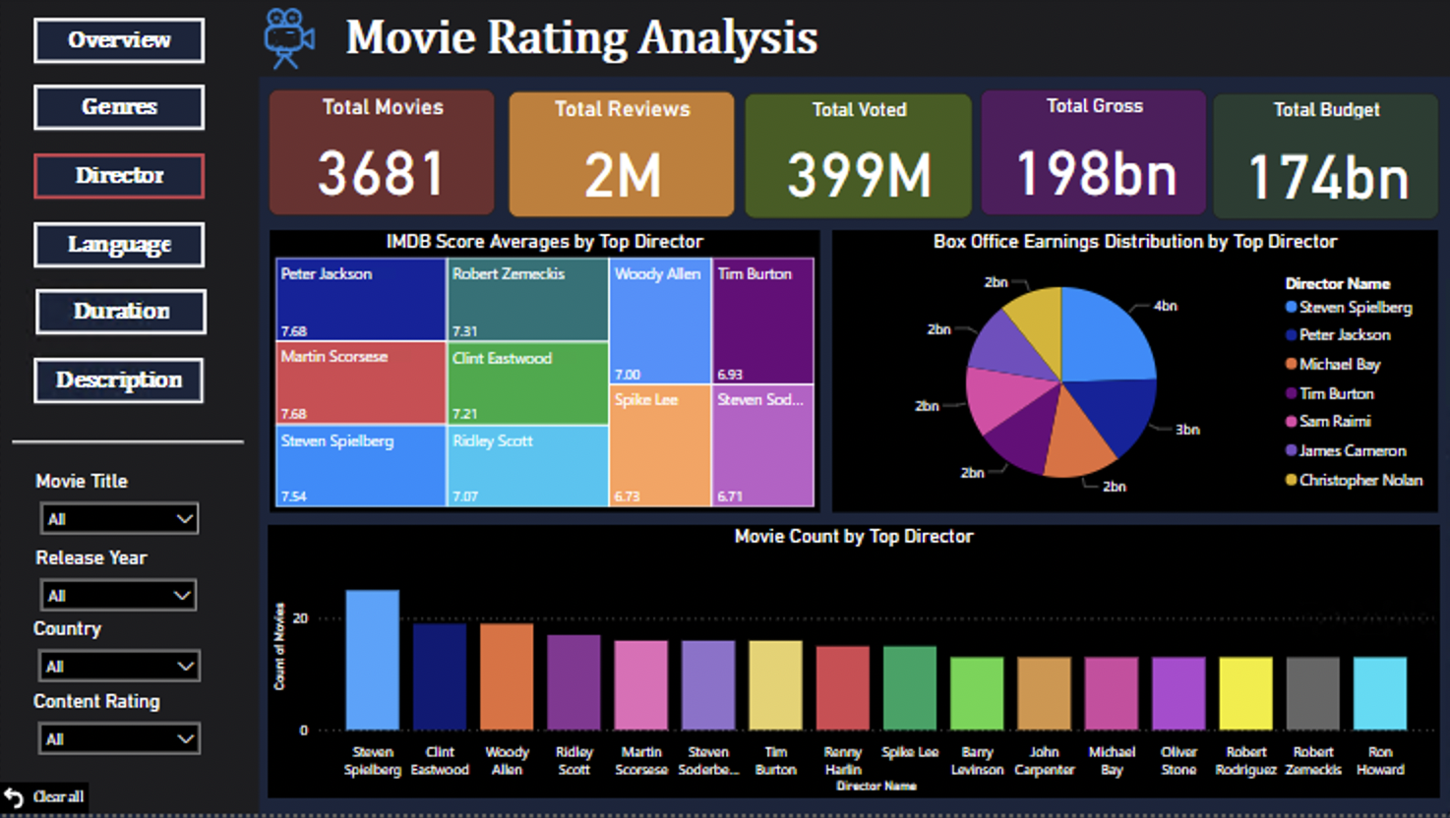
Power BI Dashboard: Director

Slide 13
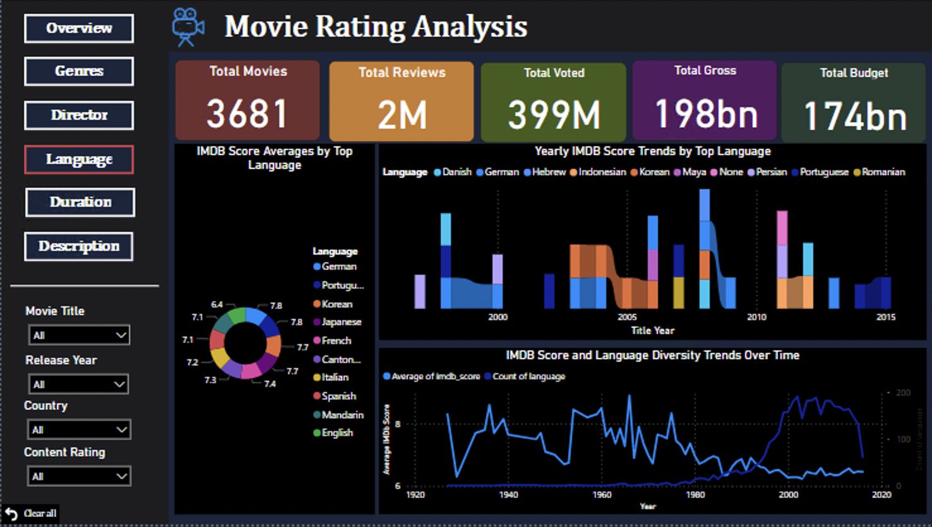
Power BI Dashboard: Language

Slide 14
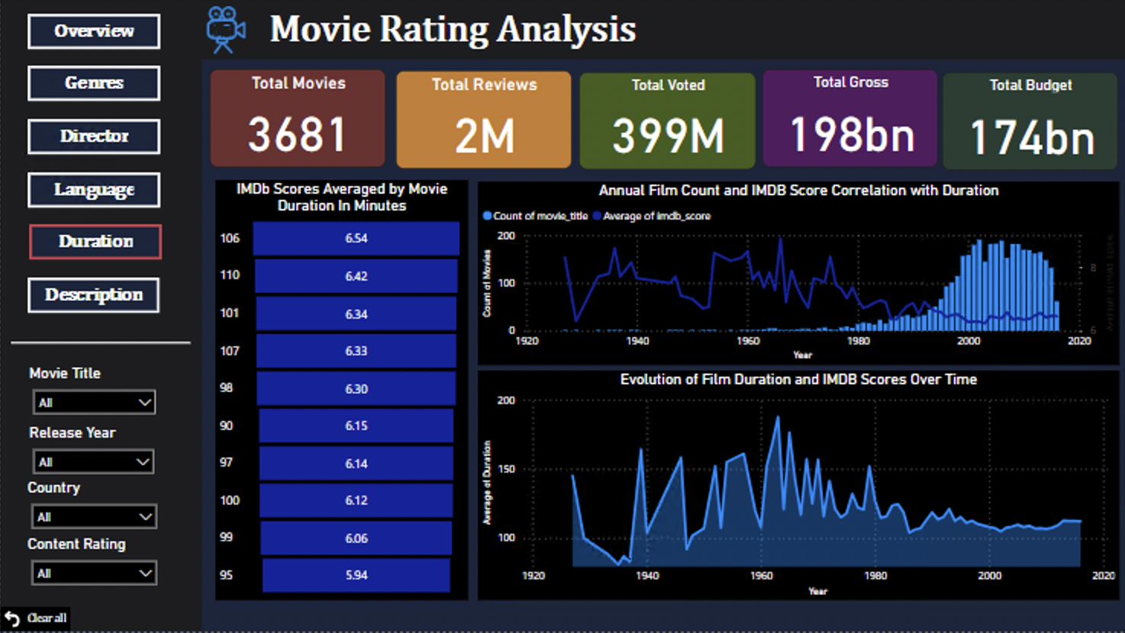
Power BI Dashboard: Duration

Slide 15
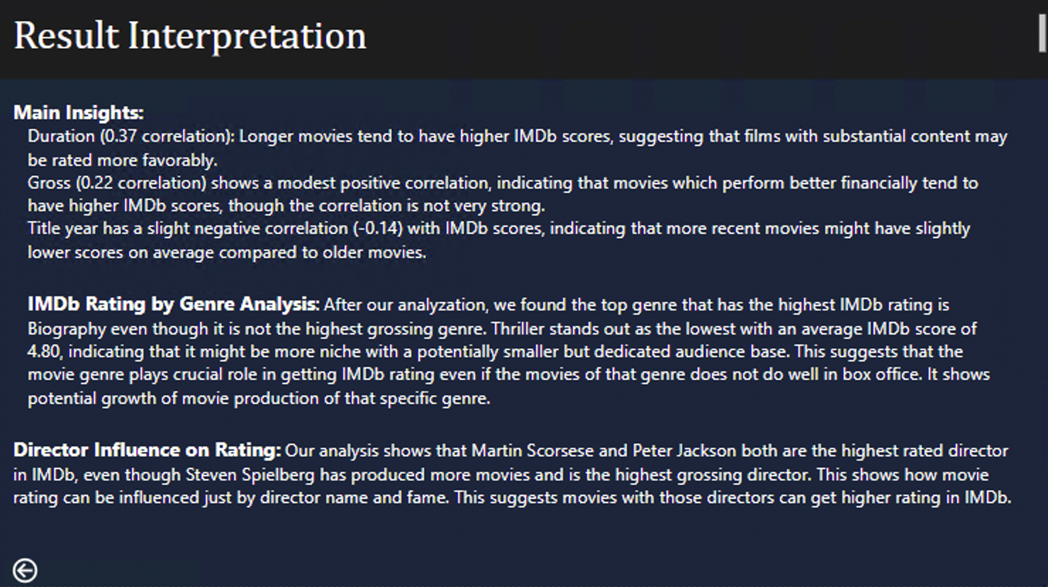
Power BI Dashboard: Description

